Slide 1
Neural Network based Image Classification System on Heterogeneous Platforms
Linjuan Fan- Ibrahim Bouriga- Andres Stober- Bahaa Mahagne- Mehyar Cherni

Slide 2
Overview
I - What is Hepics ?
Software engineering applications
Tools
II - Final Design
Implementation Problems
Libraries
Functionality Description
III - Statistics and numbers
IV - Throwback to the requirements
V - Test run
VI - Questions

Slide 3
What is hepics ?
Hetergeneous Platform for an Image Classification System

Slide 4
HePICS
A project of a software serving as an image classification system in the frame of the software engineering practise.
Software engineering as discipline :
Waterfall Model : Requirement analysis, Design, Implementation, Testing, Deployment and Maintenance
Document-driven software development
Design patterns
Task distribution
Version-control
Tools :
Eclipse for C++, QtCreator
Git , GitHub
Design tools : creately.com / StarUML / QtDesigner / Balsamic Mockups

Slide 5
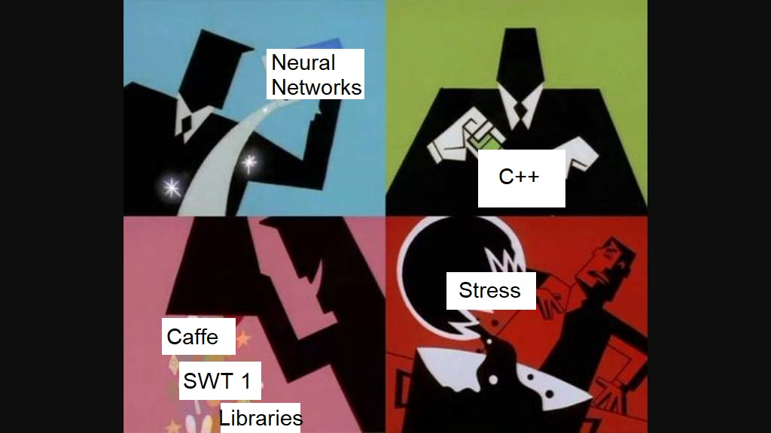
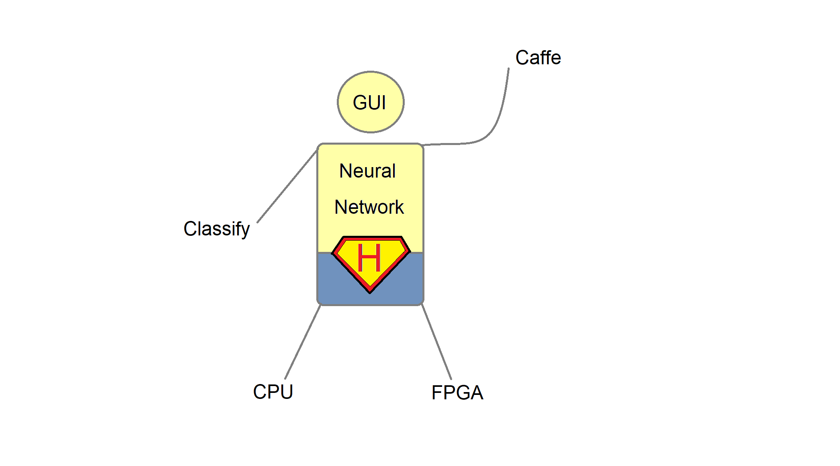
The Making Of Hepics :

Slide 6
HOW is hepics ?
Hetergeneous Platform for an Image Classification System

Slide 7

Implementation Problems
Reading images
Misunderstanding of the different layers
Leading to the RE-Family
Refactoring, Rebuilding, Redistributing tasks, Retesting
Libraries
Image handling, GUI : Qt5Gui, Qt5Widgets, Qt5Core
Parser, Network Model, Inspiration : Caffe
Testing : GoogleTest

Slide 8
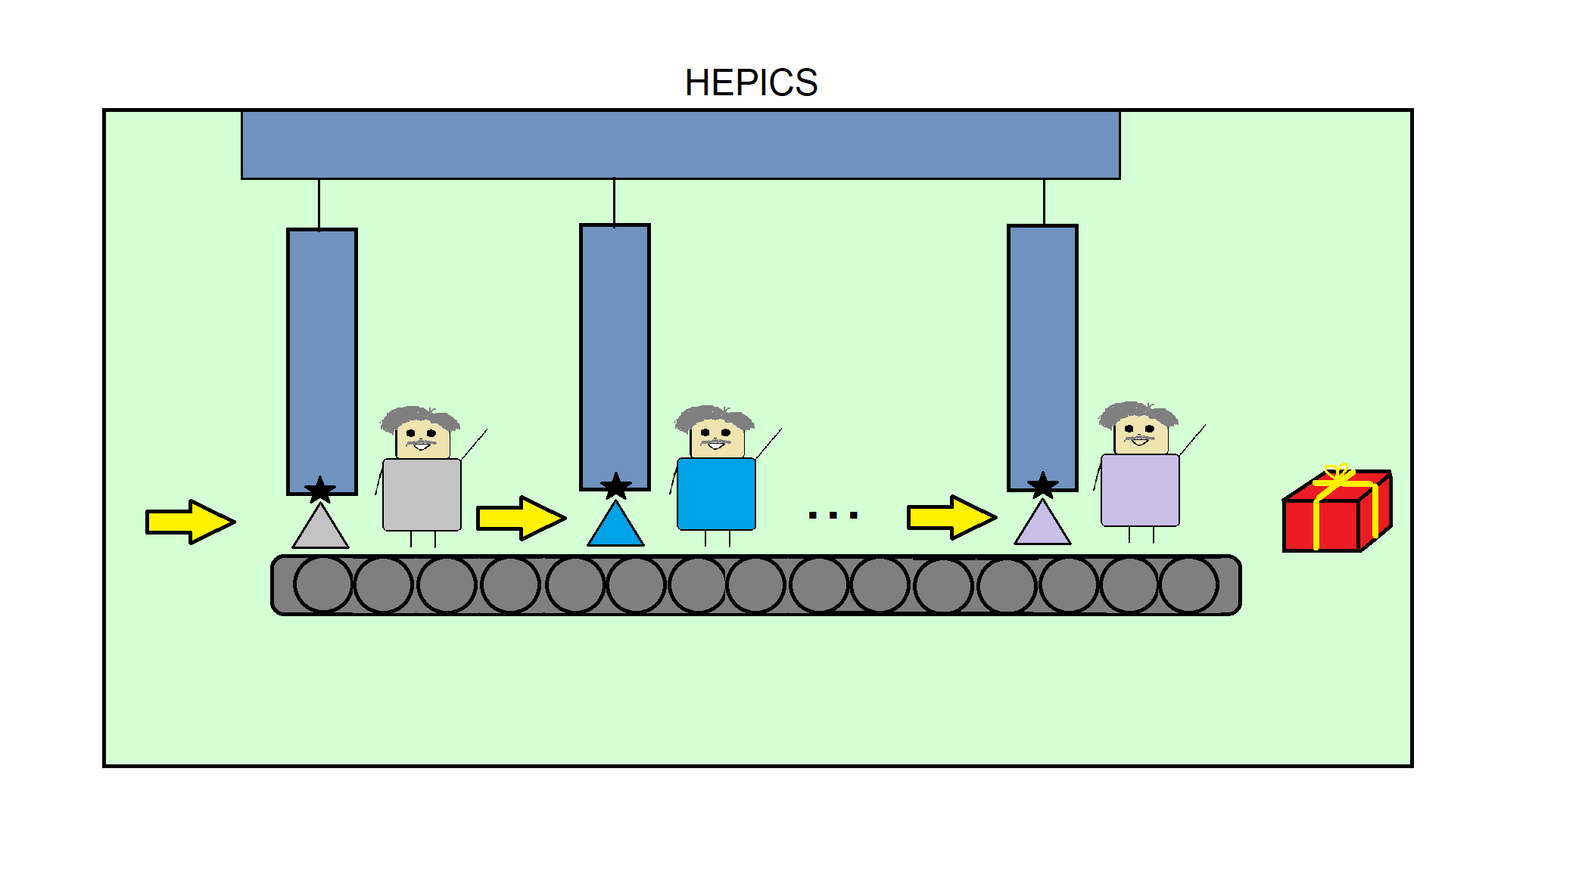
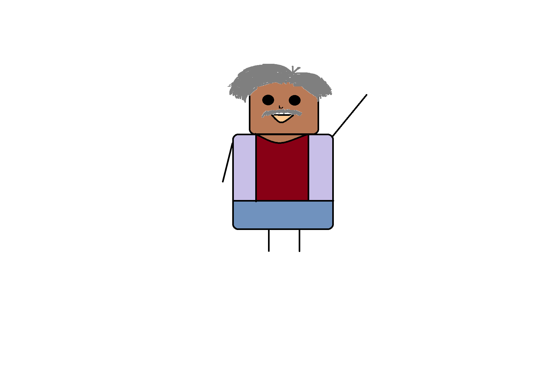
Final Design Description
Meet Sir Max !

Slide 9
Statistics & numbers
Hetergeneous Platform for an Image Classification System

Slide 10
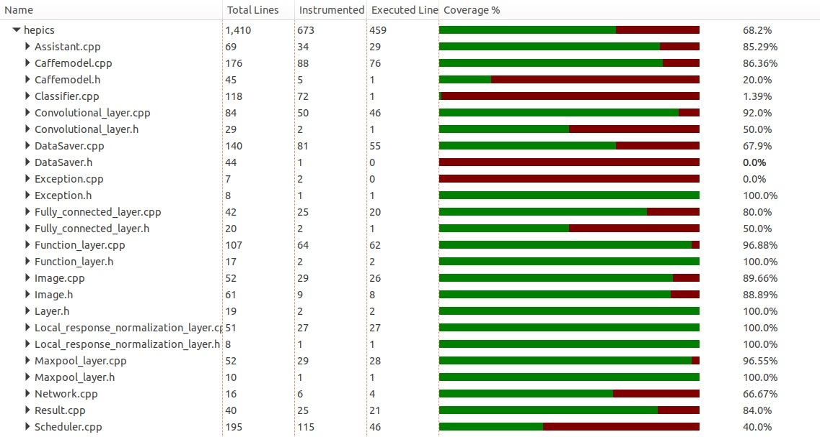
Check the statistics
Lines of code : ~3400 in total, 20% are comments or whitespaces
Branches : master (presentations and documents mainly) + ~13 branches
Commits : 340
Tests : 15 Test classes, more than 30 test cases
Coverage : 68%

Slide 11
It’s rewind time
Hetergeneous Platform for an Image Classification System

Slide 12
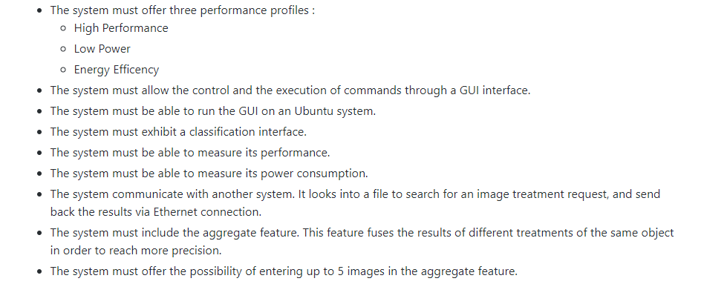
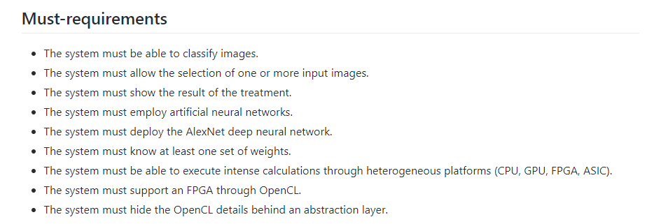
Requirements :

Slide 13
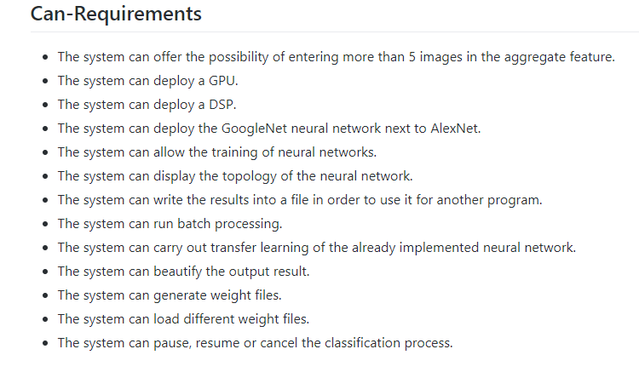
Can Requirements

Slide 14
Show time
Hetergeneous Platform for an Image Classification System

Slide 15

Enough words for now, time for a demo !

Slide 16
Ask us
Hetergeneous Platform for an Image Classification System

Slide 17
Please feel free to ask us questions.
?
?
?
?
?

Slide 18
Thank you for your time !
Hetergeneous Platform for an Image Classification System

